Slide 1
SBC - DALI64SYLKPSU BMS Integration Scope & Introduction
The purpose of the application example is to give guidance and facilitate the implementation of the dali64sylk system in combination with IRM PCD7.
The prerequisites for use are basic knowledge of the IRM system and its configuration through the PG5 Configurator.
The program, PG5 project, DALI64 IRM is a basic application.
The FBOXes created specifically for interfacing DALI64SYLK are embedded in the application to provide the example of integration with PCD7 IRM.
The fboxes can be repeated in the program in order to create a customized base as you like that is compatible with what is required on the system to be commissioned.
The SBC Support Team is available to provide the details of the DALI64 system as well as demos.
The application is subject to modification and improvement by the SBC team who will inform you about possible updates.

Slide 2
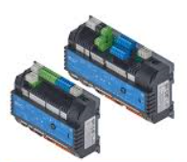
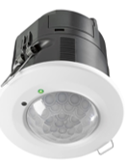
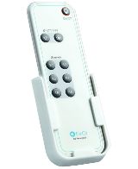
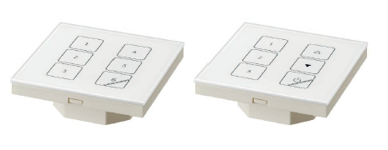
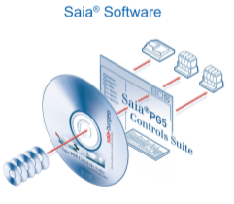
SBC - DALI64SYLKPSU BMS Integration Components
IEC 62386
www.digitalilluminationinterface.org
https://sbc-support.com/en/product-category/programmable-room-controller/pcd7lrxx-p5-pg5-programmable-room-controller/
BUS DALI
BUS DALI
BUS DALI
Scene Plates
6 scene
3+3 Multi - Select
Master Sensor DALI64SYLKPSUxx
Extended Sensor DALINETx
App. Config.
Light Touch
BLE SWITCHES
Quick Control
Dali Interface DLS4IM
4 wired input Switches
Commissioning via App

Slide 3
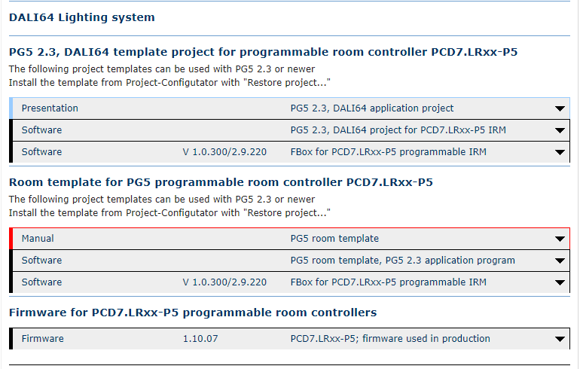
DAIL64SYLK- IRM PCD7 SBC support Portal
Where to find all the related documentation
https://sbc-support.com/en/product-category/programmable-room-controller/ pcd7lrxx-p5-pg5-programmable-room- controller/

Slide 4
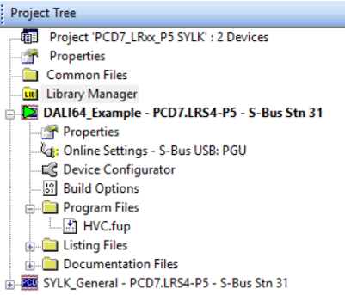
PG5 Sbc application example and Fbox library
Library in use:
Current Version IRM_SP1_0_300 _ml.
Any modification about demo Application and Library will be published and update on the Official SBC support webportal
Project Application:
Mind to check the IRM hardware model in use. ( compatibility )
Application Demo based on PCD7.LRS4 Model

Slide 5
PG5 Sbc application example and Fbox library

Slide 6
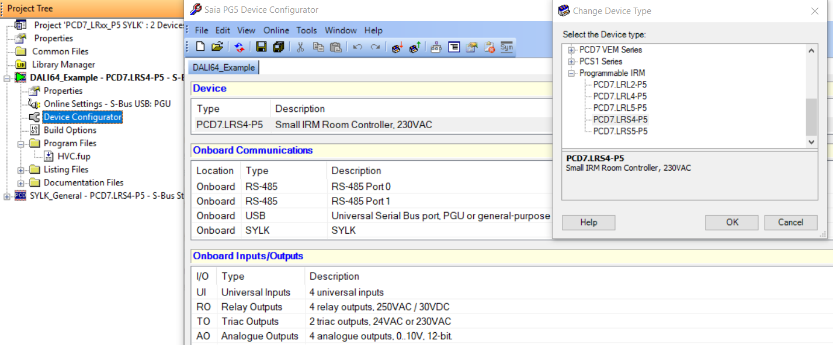
PG5 Sbc application example and Fbox library
Hardware type modification procedure

Slide 7
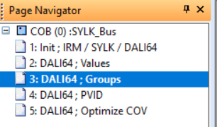
PG5 Sbc application example and FBox library
Application splitted in pages referred to the topic covered
In Principle for a better understanding and to facilitate the commisioning experience is suggested to maintain the following structure.
It can be extended based on the complexity of project designed

Slide 8
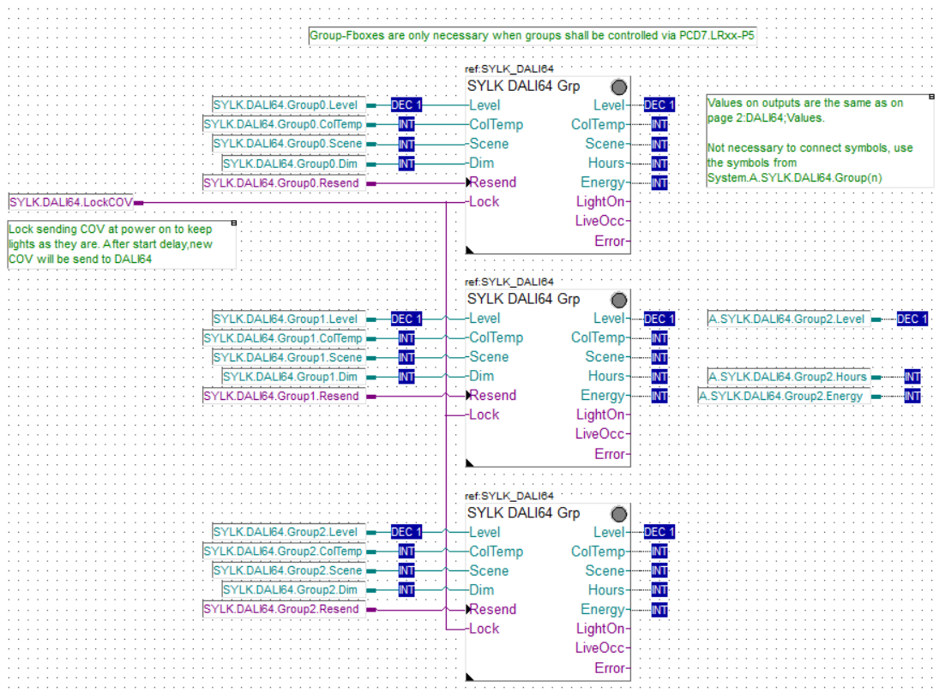
PG5 Sbc application example and FBox library
To get better familiar with application Sample additional Tips and Notes based on labels have been added to the SW. application pages.
Pages can be then freely customized by the partner as well depending on the design specification and Light Touch App Project Realized

Slide 9
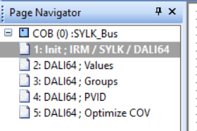
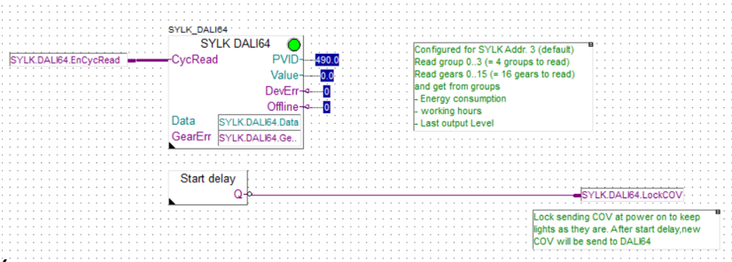
PG5 Sbc application example and FBox library
SYLKBus Life check
Increasing Counter = BUS Up and Running
DALI64SYLK Master Sensor FBox

Slide 10
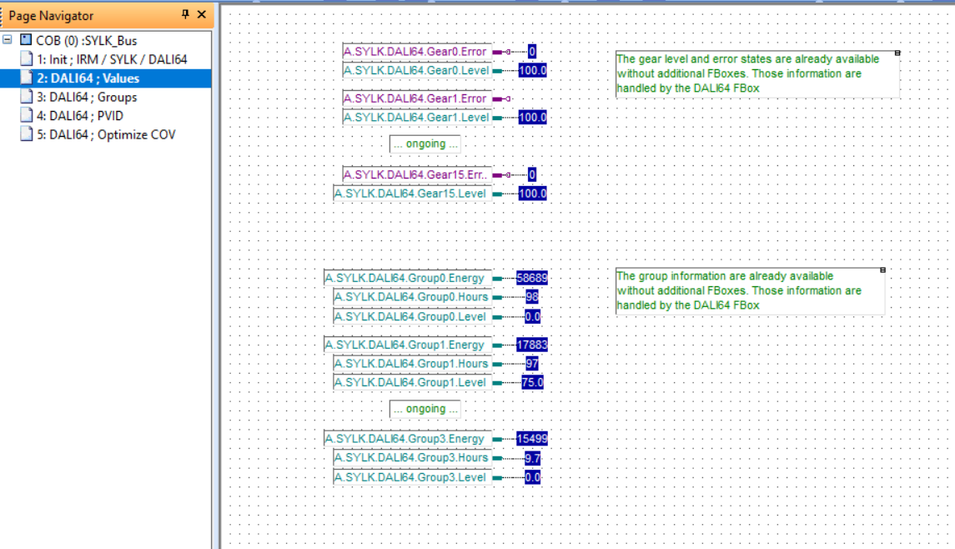
PG5 Sbc application : Values
Predefined list of Values Mapped to the Application Pages.
Helpful Page to easily list all the variable PVID reading implemented in the Application
No need to create a specific Application Watch list for the scope.

Slide 11
PG5 Sbc application : Group FBox
Dali Group Control FBox
Based on the Application created via Light Touch is possible Monitor and Command DALI Groups. ( eg: LiveOcc output monitor the occupancy detection )
Group 0 is the default Group associated by the App. ( it ‘s often used to switch ON-Off all the gears . The related DALI command could be associated @ a time based event from the BMS in order to issue eg. a Time schedule feature)
All the gears discovered on the bus by the App during the Commisioning will be grouped here without any possibility of Custom Modification.

Slide 12
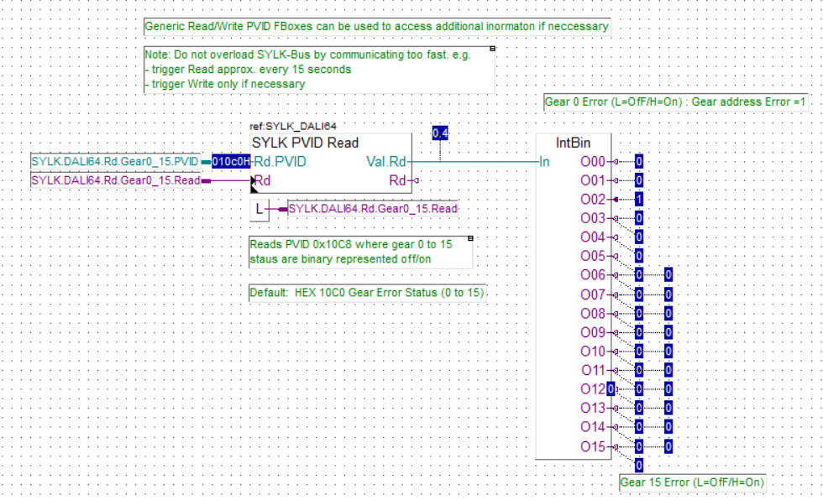
PG5 Sbc application : SYLK PVID read
Generic Fbox for reading PVID Sylk bus data packet:
Here the example about gears error.
Oxx = 0 No gears Error
Oxx= 1 Gear Error detected
O02 set @ 1 = gears 002 disconnected form the Dali bus.

Slide 13
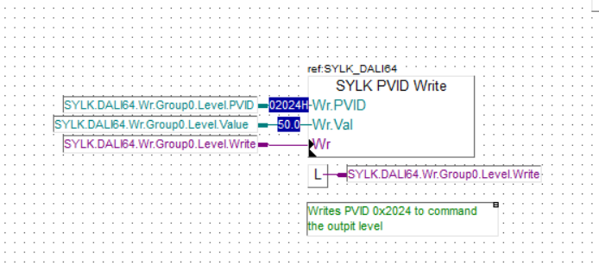
PG5 Sbc application : SYLK PVID Write
Generic Fbox for Writing PVID Sylk bus data packet:
Here the example about how to impose a light Level on Group0
Group0 PVID Address
Light Level Value
Click here to execute a Trigger feature in order to send the above defined command over the DALI bus
Application Hint

